Slide 1
WDD 230: Web Accessibility
Spencer Carillo

Slide 2
What is Web Accessibility?
Accessibility is the practice of preventing barriers from allowing those with disabilities to access the websites on the internet
When sites are correctly designed, developed and edited, it allows all users have equal access and functionality.
Can help those with
Visual problems – blindness, color-blindness, low vision
Cognitive problems – learning disabilities
Auditory problems – deaf and hard of hearing
Motor problems – slow response time

Slide 3
Principles of Web Accessibility
Perceivable – allows the user to see and hear everything on display
Operable – users can interact with keyboard, mouse easily
Understandable – content is clear and not confusing
Robust – can be accessed by various technologies new and old

Slide 4

Good examples of accessibility
Good use of HTML headings.
Accessible with keyboard.
Accessible images.
Accessible menus.
Accessible forms.
Accessible tables.
Effective use of color.
Meaningful link text.

Slide 5
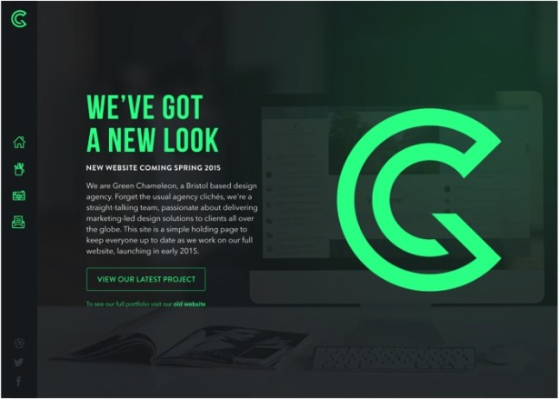

Contrast Colors

Slide 6

Text-to-speech and voice-recognition
Mobile devices provide users with the opportunity to input audio to text and can use this to ask questions and find directions

Slide 7
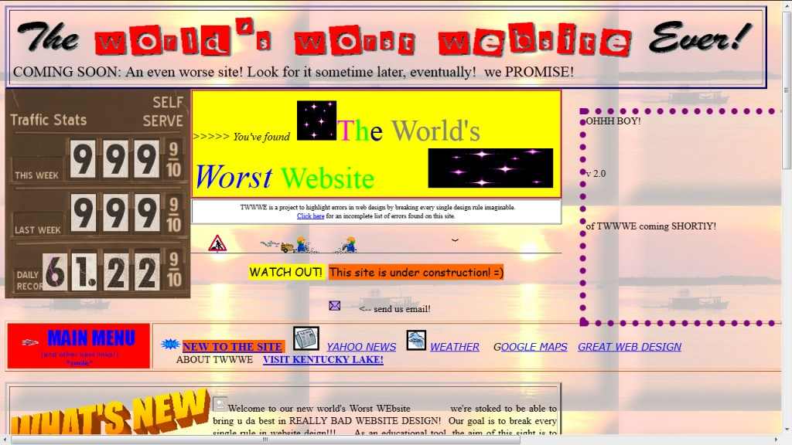
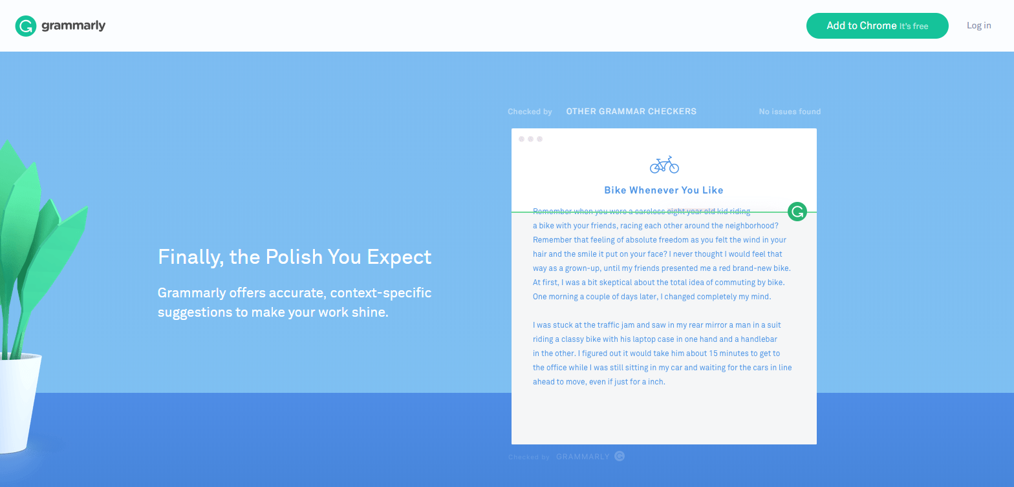
Layout Design

